Slide 1




Advancing an Information Model for Environmental Observations
CUAHSI
HIS
Sharing hydrologic data
Support EAR 0622374
Jeffery S. Horsburgh
Anthony Aufdenkampe, Richard P. Hooper, Kerstin Lehnert, Kim Schreuders, David G. Tarboton

Slide 2










The Original Problem Combining Similar Data from Disparate Sources
NWIS
request
return
request
return
return
request
request
NAWQA
return
request
NAM-12
return
request
return
request
return
request
return
request
return
NARR
Slide from Michael Piasecki

Slide 3
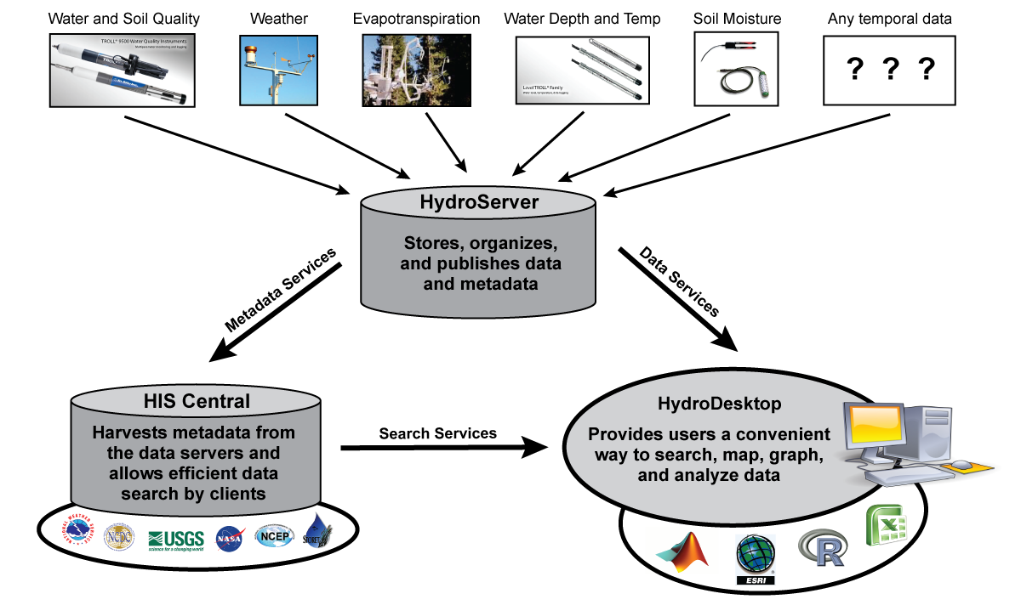
CUAHSI Hydrologic Information System A Services Oriented Architecture for Sharing Hydrologic Observations
Slide from Steven Brown

Slide 4
Point Observations-Network Information Model
USGS NWIS
Data Source
NWIS Sites
Network
San Marcos River at Luling, TX
Sites
Discharge
Variables
Observation
18,700 cfs, 3 July 2002
{Value, Time, Qualifier}
A data source operates an observation network
A network is a set of observation sites
A site is a point location where one or more variables are measured
A variable is a property describing the flow or quality of water
A value is an observation of a variable at a particular time
A qualifier is a symbol that provides additional information about the value

Slide 5
Data Values – Indexed by “What-Where-When”
Time, T
“When”
t
A data value
v_{i} (s,t)
s
“Where”
Space, S
V_{i}
“What”
Variables, V

Slide 6
Data Series – Time Series of Data Values
Time
There are n measurements of Variable V_{i} at Site S_{j} from time t₁ to time t₂
End Date Time, t₂
Count, n
Begin Date Time, t₁
Site, S_{j}
Space
Variable, V_{i}
Variables

Slide 7
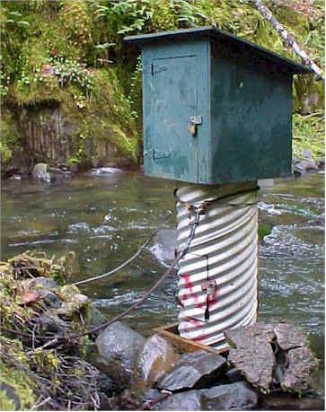
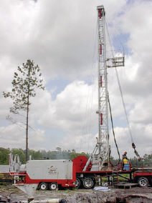
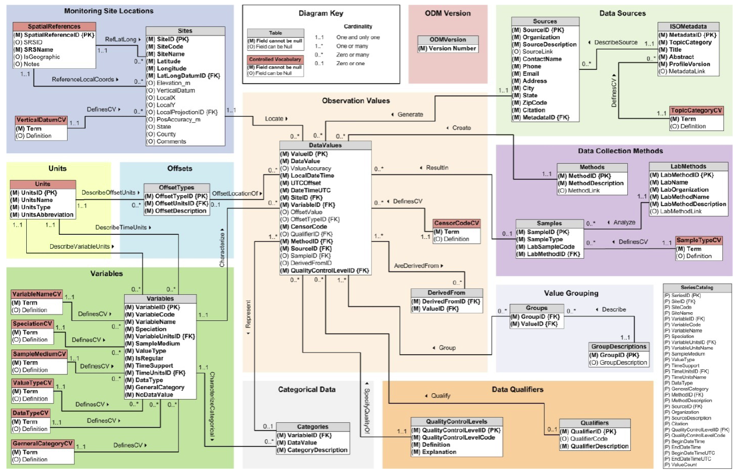
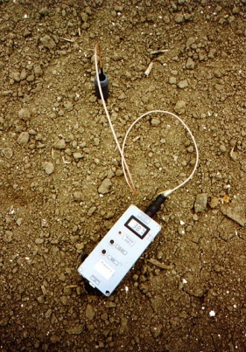
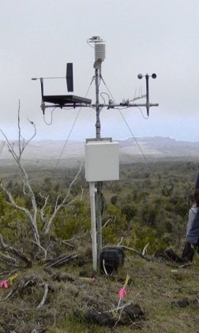
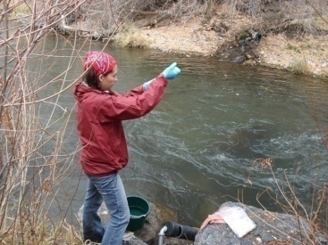
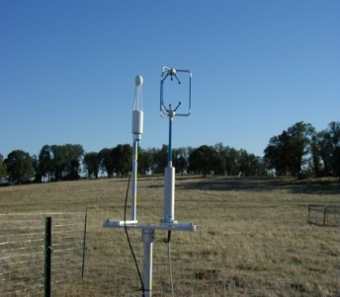
Observations Data Model (ODM)
Streamflow
Groundwater
levels
Precipitation
& Climate
Soil
moisture
data
Water Quality
Flux tower data
A relational database at the single observation level
Metadata for unambiguous interpretation
Traceable heritage from raw measurements to usable information
Promote syntactic and semantic consistency
Horsburgh, J. S., D. G. Tarboton, D. R. Maidment, and I. Zaslavsky (2008), A relational model for environmental and water resources data, Water Resources Research, 44, W05406, doi:10.1029/2007WR006392.

Slide 8
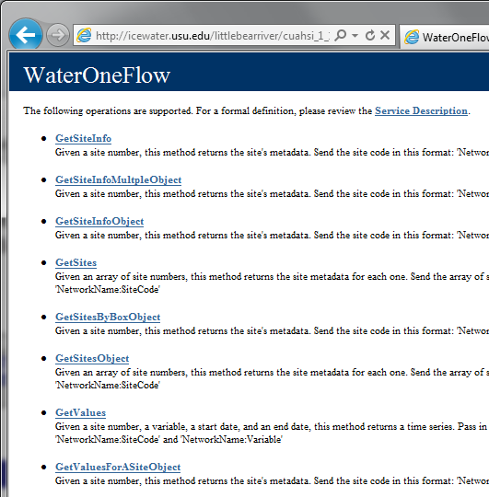
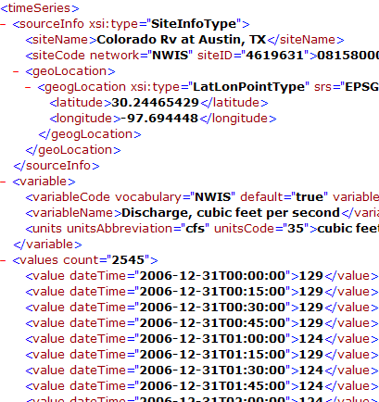
WaterML and WaterOneFlow
WaterML is an XML language for communicating water data
WaterOneFlow is a set of web services based on WaterML
Set of query functions
Returns data in WaterML
Notes:
8

Slide 9
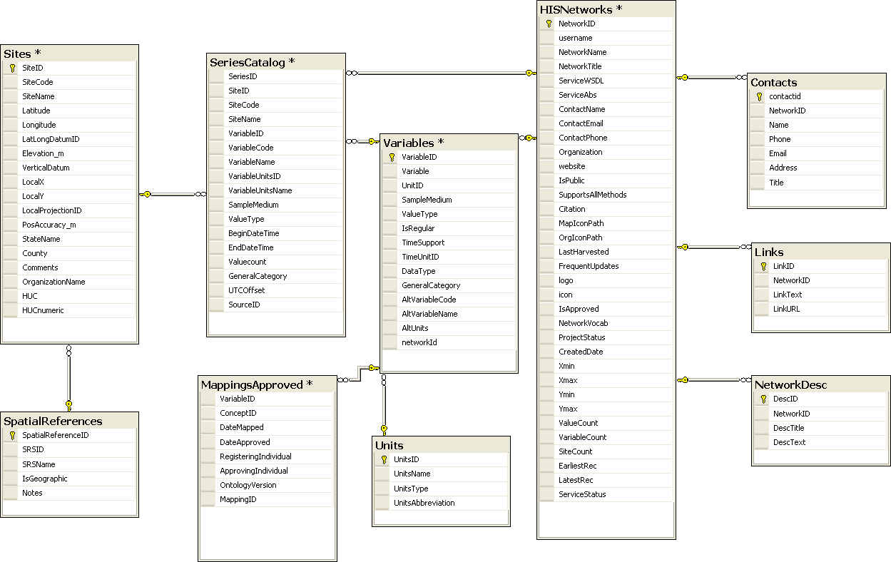
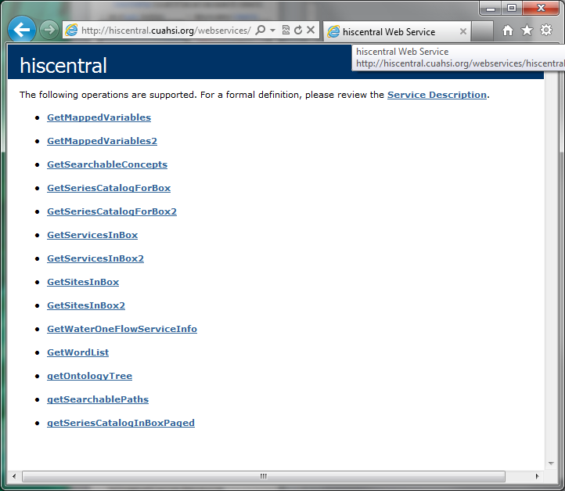
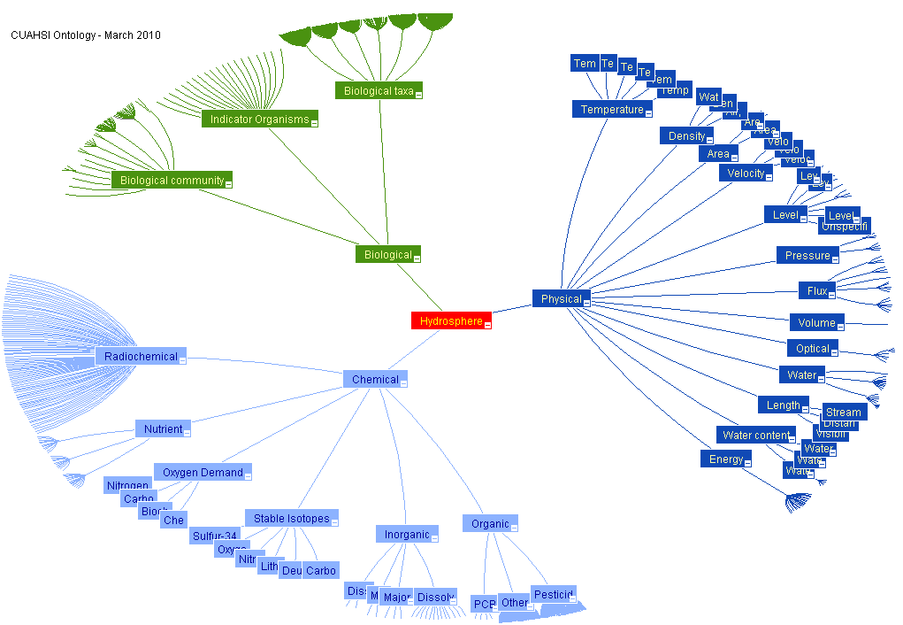
HydroCatalog http://hiscentral.cuahsi.org
Metadata Catalog Database
Service registry
Metadata harvester
Catalog database
Semantic tagging application
Data discovery services
Hydrologic Concept Ontology
Data Discovery Web Services

Slide 10
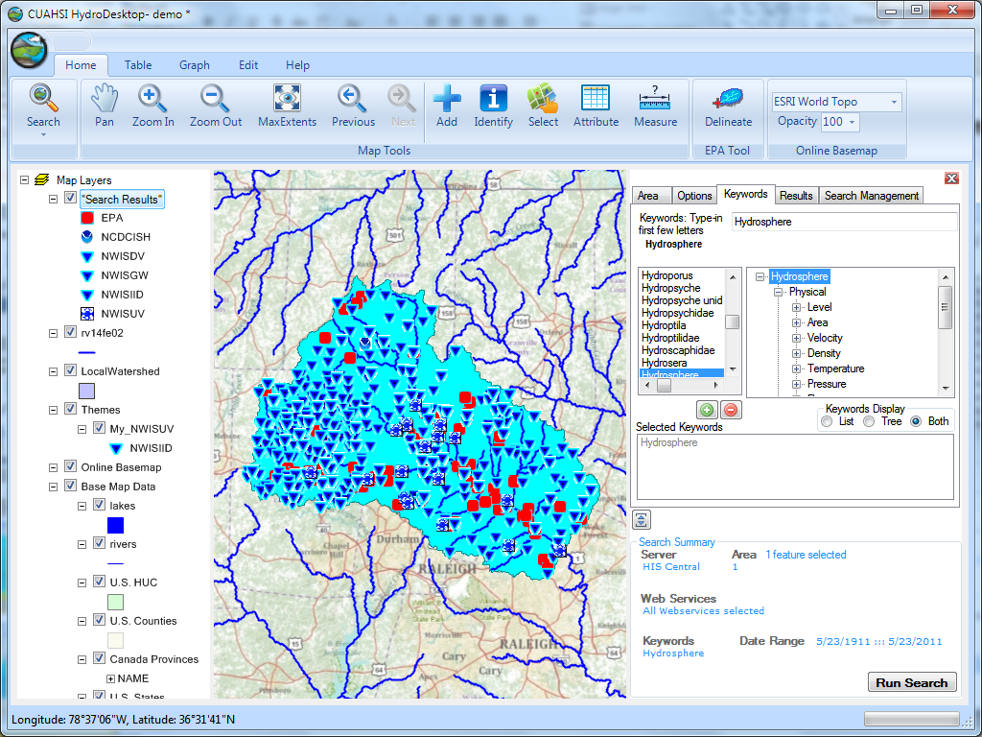
Thematic keyword search
HydroDesktop – Data Access and Analysis
Integration from multiple sources
Search on space and time domain

Slide 11
A Common Information Model Has Enabled
A greater degree of semantic and syntactic homogeneity across data sources
Ability to catalog and provide semantically enabled search services across multiple disparate data sources
Evolution toward community standards for sharing hydrologic data

Slide 12
Limitations
Works great for a limited class of hydrologic observations (e.g., point time series), BUT…
Does not adequately support some types of ex situ observations
Does not adequately support observations on geometries other than points
Does not adequately describe the “feature of interest” or the “sampled feature” or “Site Type”
Does not provide adequate ability to record provenance and annotate observations
…

Slide 13
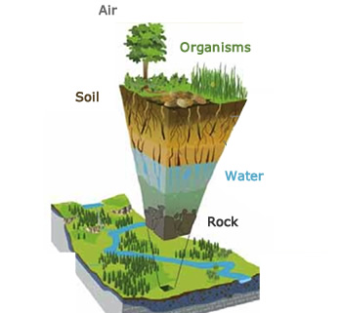
Critical Zone Research
Precipitation
Stream chemistry
Streamflow
Soil chemistry
Soil moisture
Groundwater chemistry
Groundwater levels
Solid earth chemistry
http://criticalzone.org/Research.html
Both in situ and ex situ data are critical for analysis of the critical zone.

Slide 14
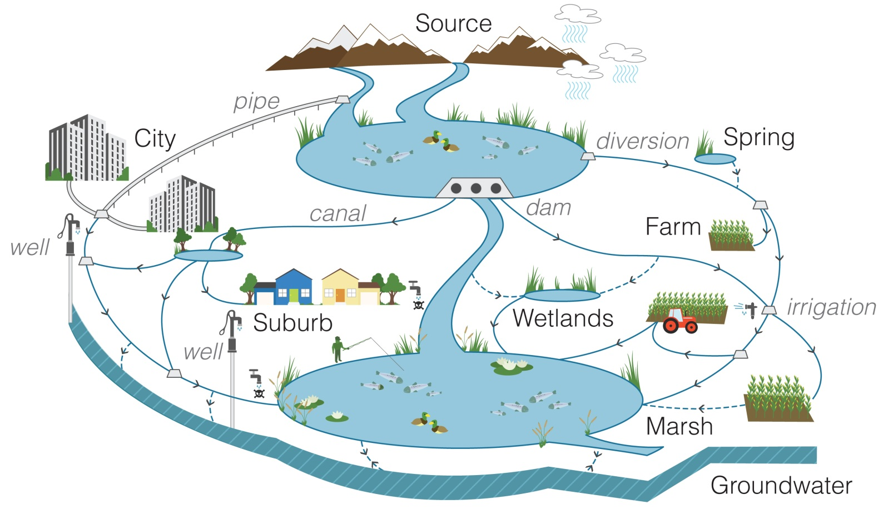
Coupled Human/Natural Systems
Snow depth, distribution, density
Precipitation
Diversions, human water management
Reservoir inflows, storage, releases
Irrigation, Evapotranspiration
Streamflow quantity, quality
Groundwater withdrawal, recharge, quality
Data representing multiple hydrologic features with complex geometries.

Slide 15
A More Flexible Information Model for Observations
A number of important advancements have emerged
Information Model
Open Geospatial Consortium Observations & Measurements
Service Interfaces
Open Geospatial Consortium Standards – particularly Sensor Observation Services (SOS)
Semantics and Integration
Scientific Observations Network (SONet)
Data Storage Model
Microsoft Research and SDSC Environmental Data Model (EDM)

Slide 16


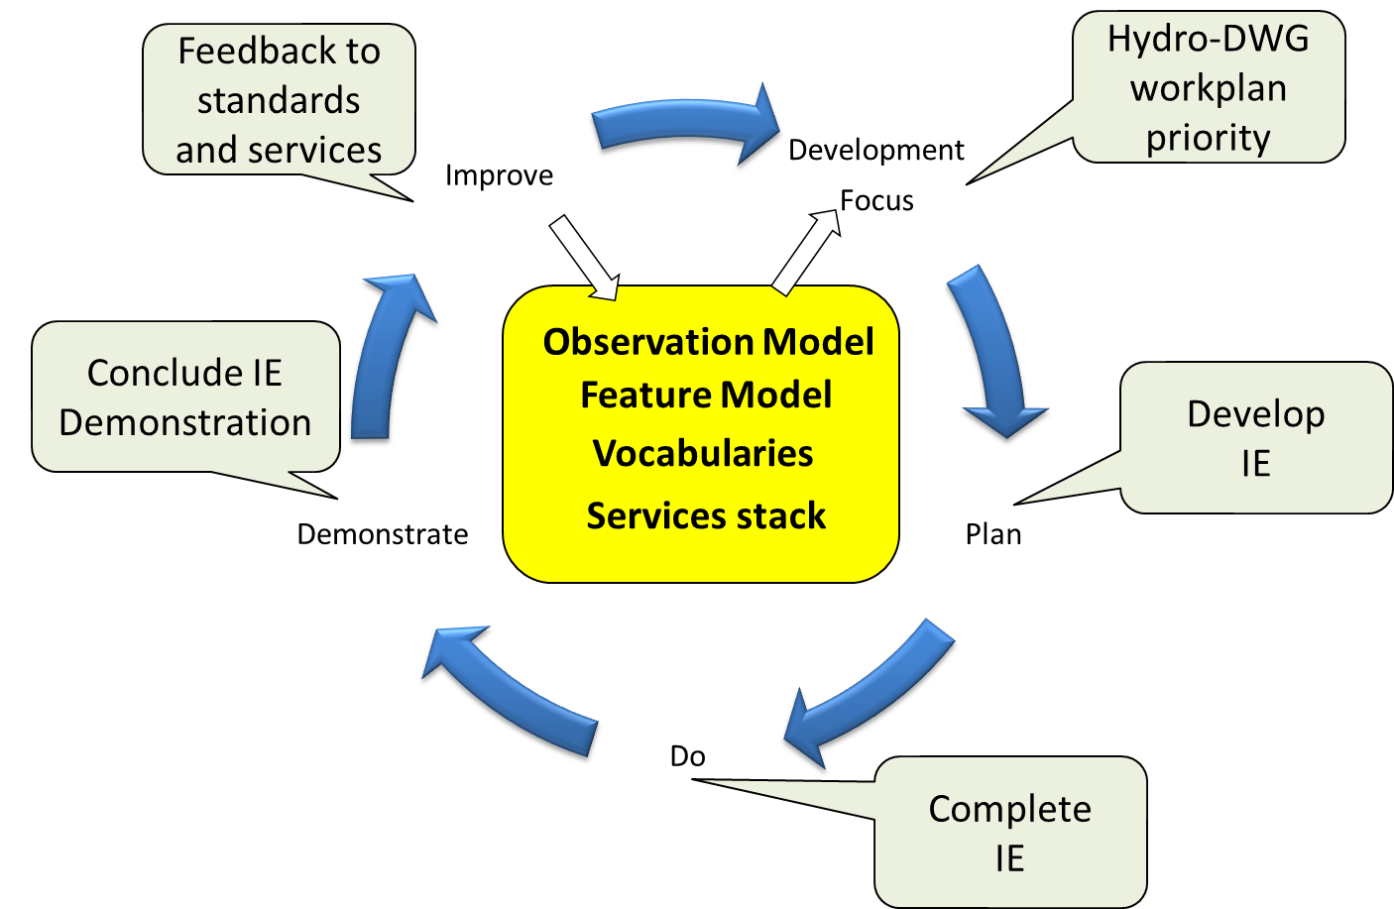
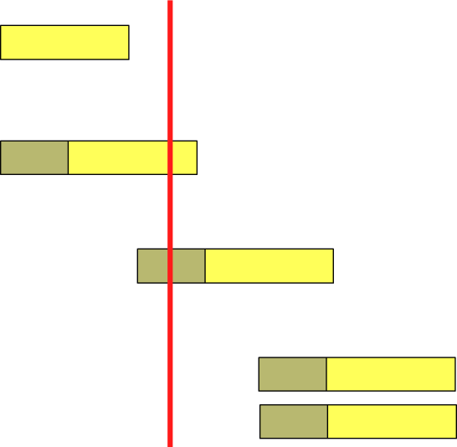
International Standardization of WaterML
http://external.opengis.org/twiki_public/bin/view/HydrologyDWG/WebHome
Hydrology Domain Working Group
- working on WaterML 2.0
- organizing Interoperability Experiments focused on different sub-domains of water
- towards an agreed upon feature model, observation model, semantics and service stack
Timeline
WaterML 2 SWG
(Mar 2011)
Iterative Development
Groundwater IE
GSC+USGS
Dec 09 – Dec 10
Surface Water IE
CSIRO+many
Jun 10 – Sep 11
Forecasting IE
NWS+Deltares?
Sep 11 – Sep 12?
Water Quality IE
Water Use IE
June’11
Slide from Ilya Zaslavsky

Slide 17
ODM 2.0
Approach: a core observational data model with flexible extensions
Samples extension – better handle storage of sample information and observations derived from ex situ analyses
Field sensor extension – better handle storage of sensor deployment information and in situ observations
Provenance and annotation – capturing more of the context of observations
A more robust “feature model” to better describe the geographic context of observations
Enhanced semantics
Harmonization with WaterML

Slide 18
Thank you!
CUAHSI
HIS
Sharing hydrologic data
Support EAR 0622374

